Slide 1
Netflix EDA

Slide 2
Introduction
Netflix is an application that keeps growing exponentially whole around the world and it is the most famous streaming platform. The Netflix dataset includes information about the TV shows and Movies available on Netflix from the year 1925 to 2020.
The objective of this analysis is to gain valuable insights into the content dynamics of the Netflix platform. This analysis aims to provide a comprehensive understanding of the content landscape on Netflix, identify factors contributing to user engagement, and highlight potential areas for content improvement or expansion. To make this project, we used technologies like Microsoft Excel, Python, R, Mongo DB, Tableau, and GitHub.

Slide 3
Dataset Attributes
The dataset has 6234 records and 12 attributes, including
Show_id: Unique ID for every Movie/Show
Type: Identifier - A Movie or TV Show
Title: Title of the Movie/Show
Director: Director of the Movie/Show
Cast: Actors involved in the Movie/Show
Country: Country where the Movie/Show was produced
Date_added: Date when it was added on Netflix
Release_year: Actual release year of the Movie/Show
Rating: TV Rating of the Movie/Show
Duration: Total Duration - in minutes or number of seasons
Listed_in: Genre
Description: The summary description of the Movie/Show

Slide 4
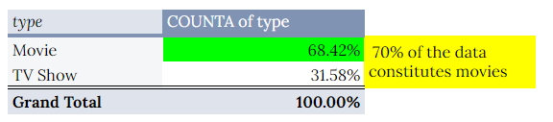
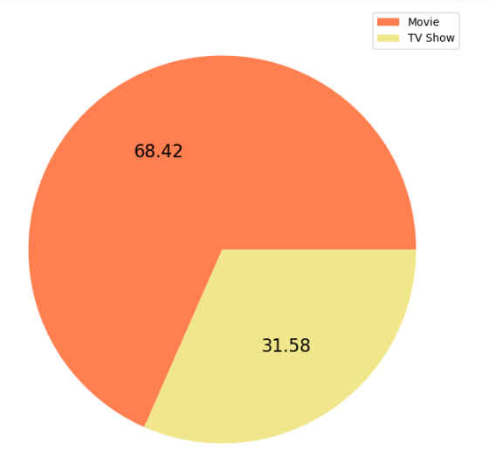
Exploration of Data
In this pivot table, COUNTA function is calculating the distinct records, while distinguishing between movies/tv shows in a (6234, 12) dataset.

Slide 5
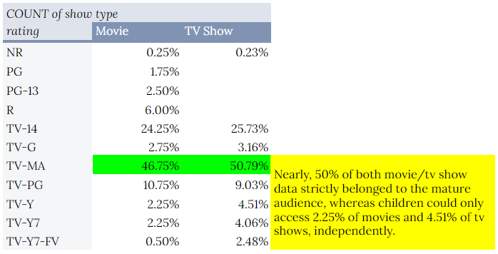
Exploration of Data

Slide 6
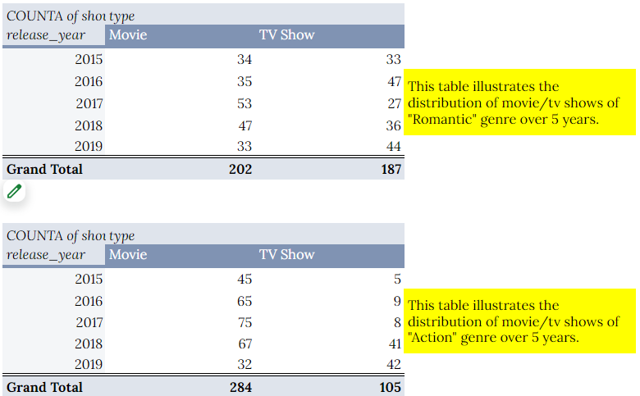
Understanding Data

Slide 7
Hypothesis & Goal
Hypothesis: The popularity and success of Netflix content are influenced by a combination of genre, release year, director, cast, and ratings, impacting user engagement and platform performance.
Goal: Analyze content attributes such as genre, release year, director, cast, and ratings to identify trends, correlations, and factors contributing to the reception and performance of content on Netflix.

Slide 8
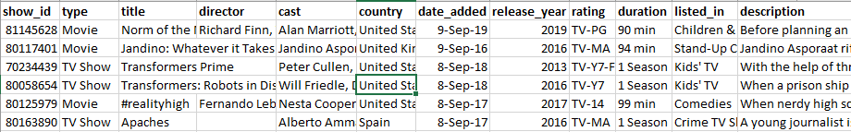
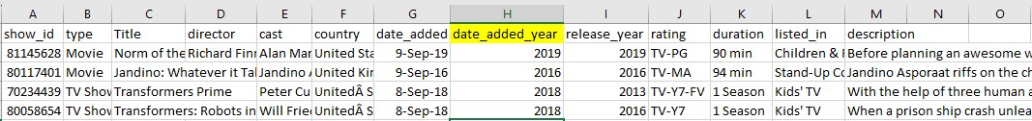
CLEANING
RAW DATA
Addition of column

Slide 9
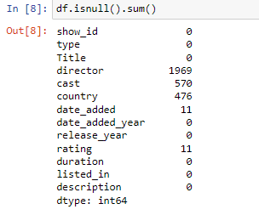
Data Cleaning Using Pandas
This has returned a pandas Series where the index represents column names, and the values represent the total number of missing values in each column of the DataFrame. This can be useful for quickly assessing the extent of missing data in your dataset.

Slide 10
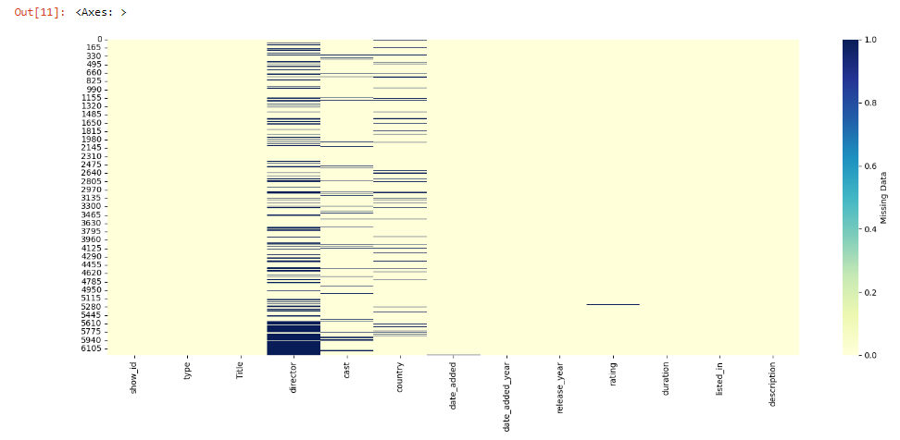
Using python’s matplotlib and seaborn libraries, we have created a heatmap to visualize missing data in a dataframe.

Slide 11
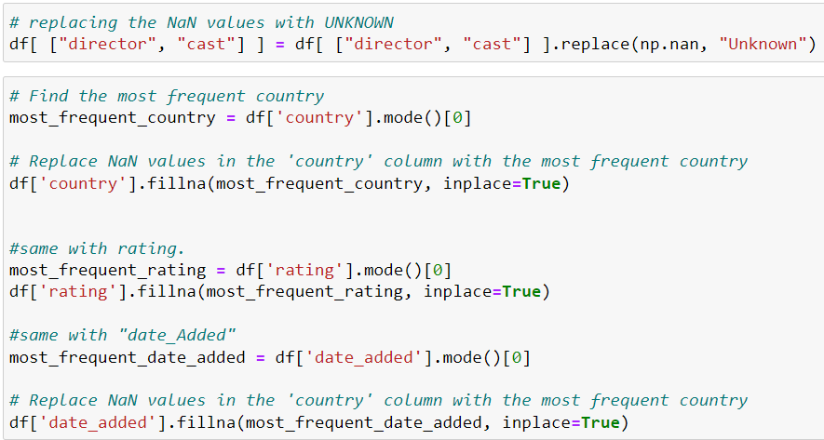
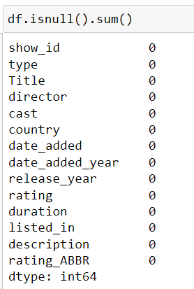
The null values were identified and replaced with “unknown” for the attributes, namely director and cast, whereas for country, rating, and date_added with their respective modes.

Slide 12
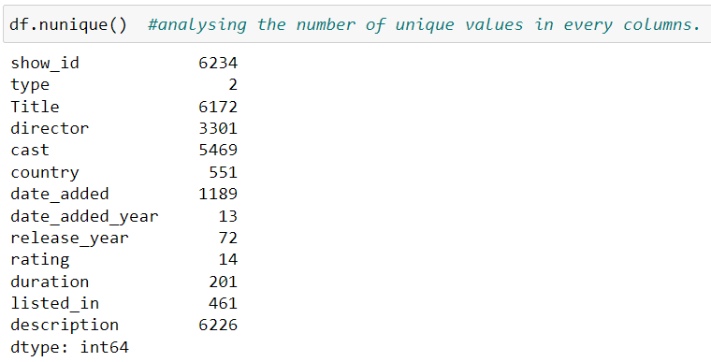
Searching for Duplicates
Clearly, there are no duplicate values in our dataset because the no. of unique values in show_id matches the total no. of records in our dataset.

Slide 13
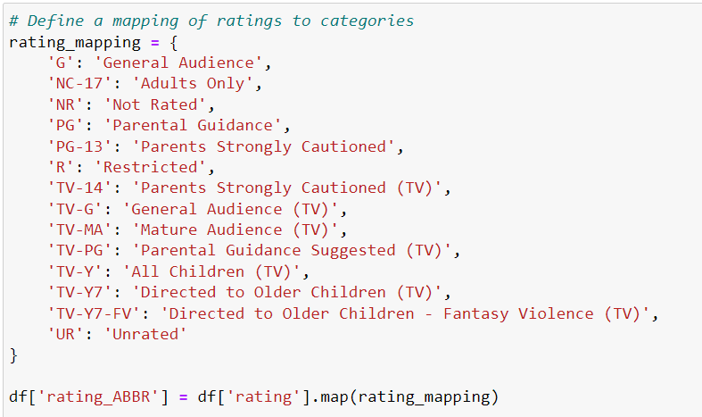
To simplify the understanding of the rating attribute, we have created an additional column signifies the audience of the movies/tv shows.

Slide 14
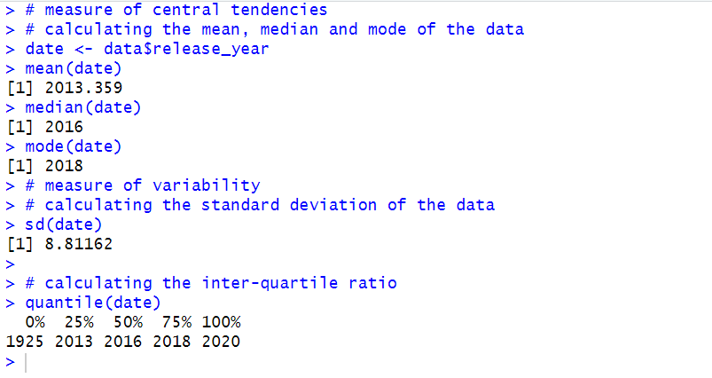
Data Cleaning Using R
The first challenge involved loading the data in R, and figuring out the structure of the Netflix data, including analysing the central tendencies (mean, median, mode) and variability of the year movies/shows were released.

Slide 15
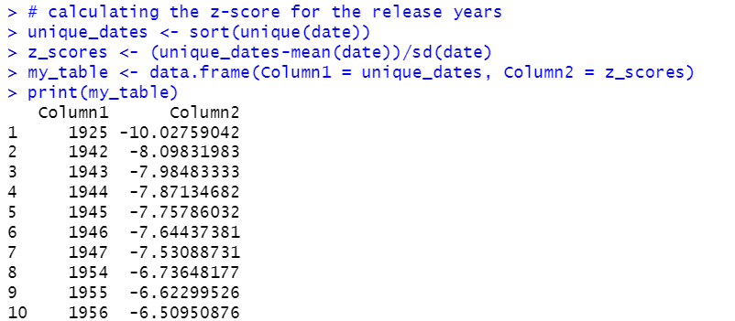
Data Cleaning Using R
The z-score for each of the release year implied the degree of variability from the mean. Hence, we decided to eliminate the data points skewing our dataset.

Slide 16
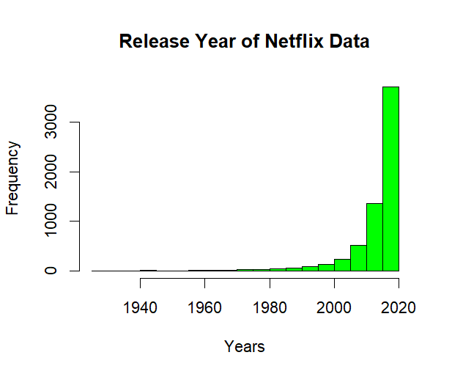
Clearly, the dataset is negatively skewed and to obtain unbiased insights, we removed the outliers, that is eliminating the data points lying beyond -0.40 and +0.70 deviation, reducing our dataset to 5056 records.

Slide 17
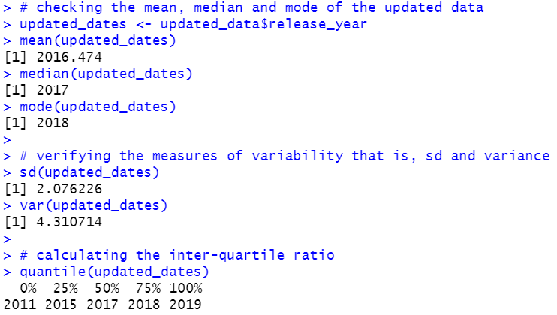
The updated dataset that is, from 2011 to 2019 has a standard deviation of approximately 2.08, and the first 25% of data points are from 2011 to 2015 instead of spanning over an century. Furthermore, the difference between the mean and median reduced significantly.

Slide 18
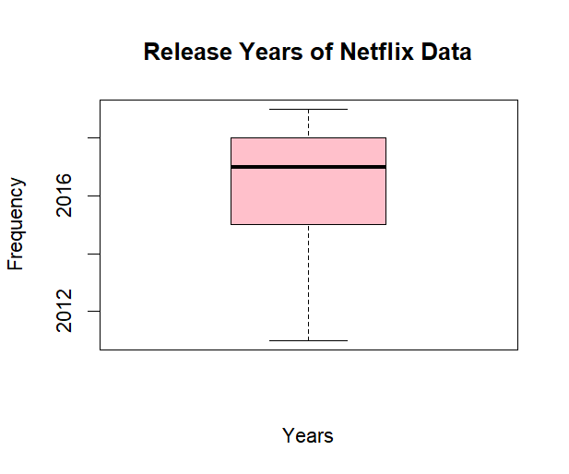
The box plot represents our data after dropping the movie records till 2010 along with 2020 movies, due to insufficient number of data points.

Slide 19
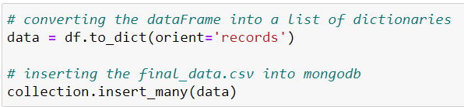
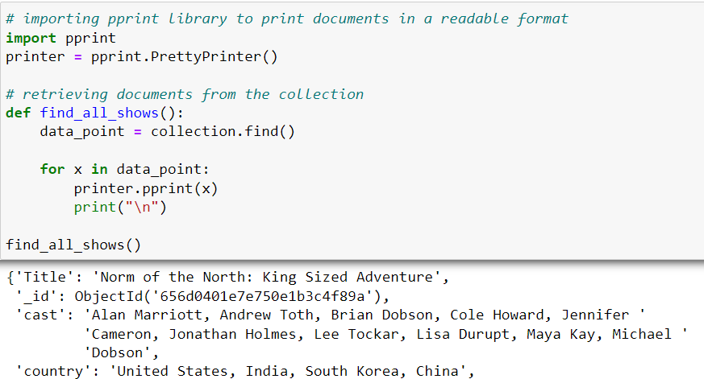
The initial step is to upload the data on MongoDB by converting the CSV file records into dictionaries, and installing “pprint” library to print documents in a readable format.
Data Analysis using MongoDB

Slide 20
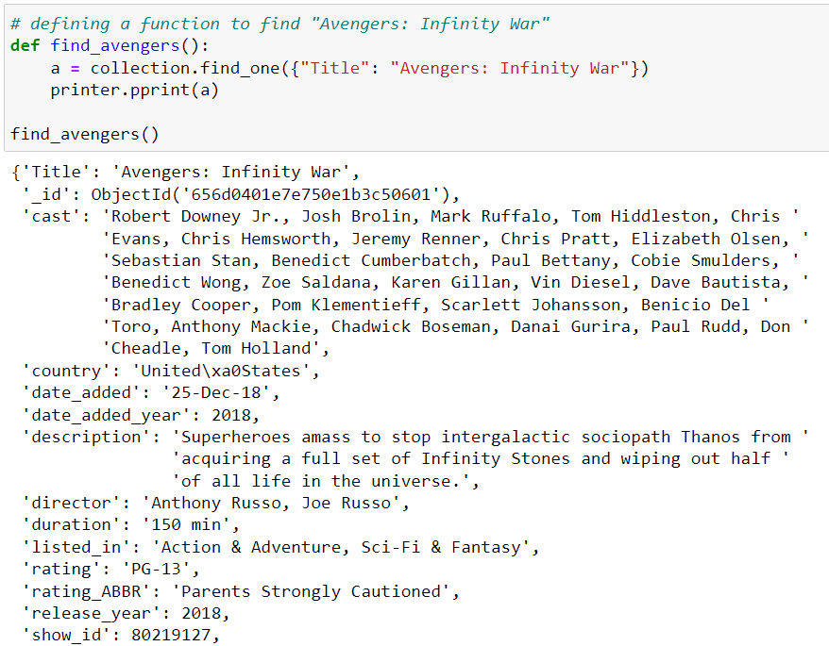
MongoDB is a document-oriented database management system. It is an extremely useful tool for data definition and manipulation.

Slide 21
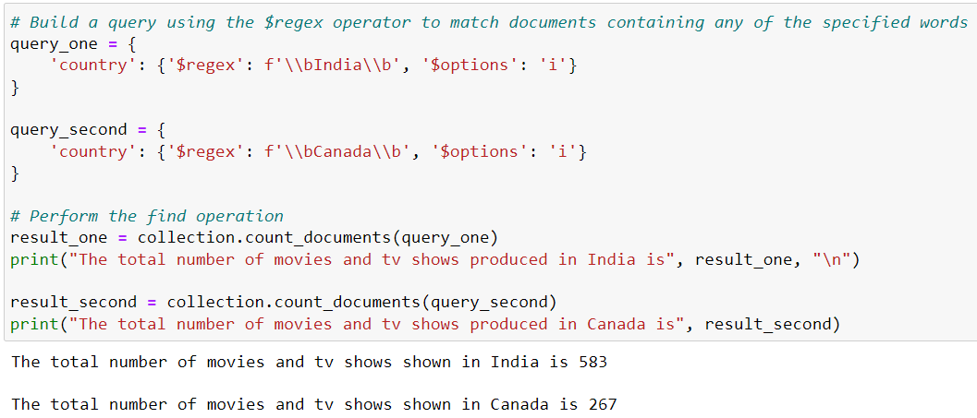
Through the $regex operator, we can find the count of movies/TV shows produced in a particular country. In fact, we can also evaluate the count of movies/TV shows falling under a specific genre, and analyze its description.

Slide 22
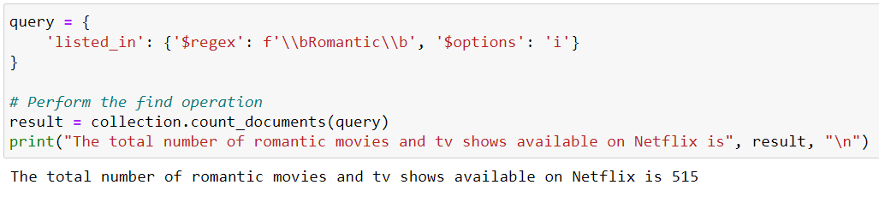
Here, we calculated the count of romantic movies/TV shows available on Netflix. But, upon further analysis we figured that some of the movies/TV shows belonging to other genres also resembled romantic drama.

Slide 23
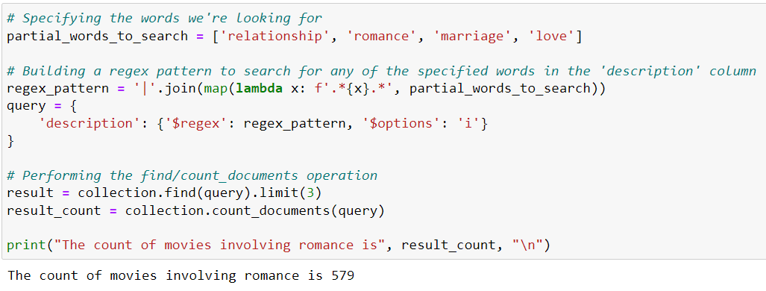
For instance, by using the $regex operator to search for a list of words, including “relationship”, “romance”, “marriage”, and “love” in the description column, we figured that the movies/TV shows involving “romance” exceed the count of movies/TV shows that actually fall under the genre by 64.

Slide 24
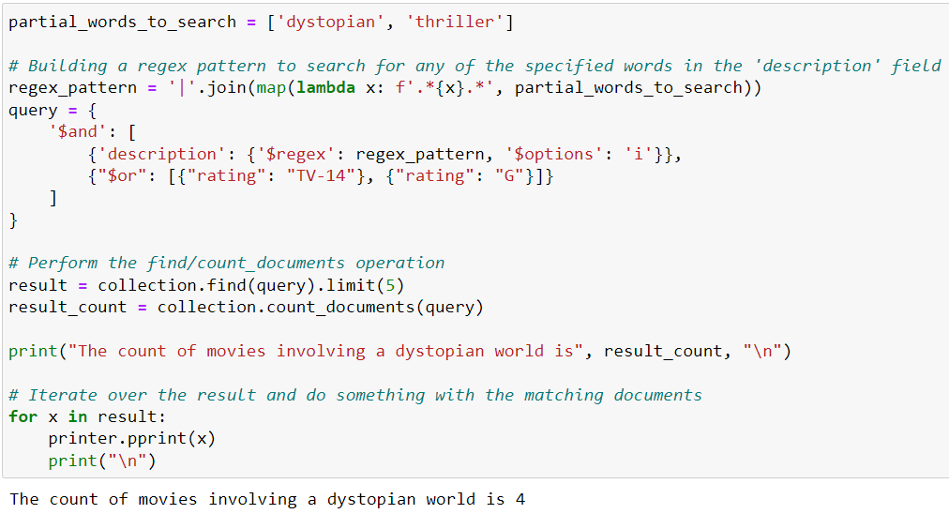
Now, if we had to find thrillers for teens, here’s the query to retrieve results.

Slide 25
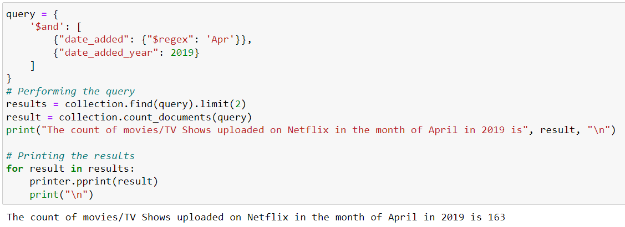
Using MongoDB, we can also retrieve the number of movies/TV Shows uploaded on Netflix in April 2019, along with the movies/TV shows released between any of the provided years to further support our analysis.

Slide 26
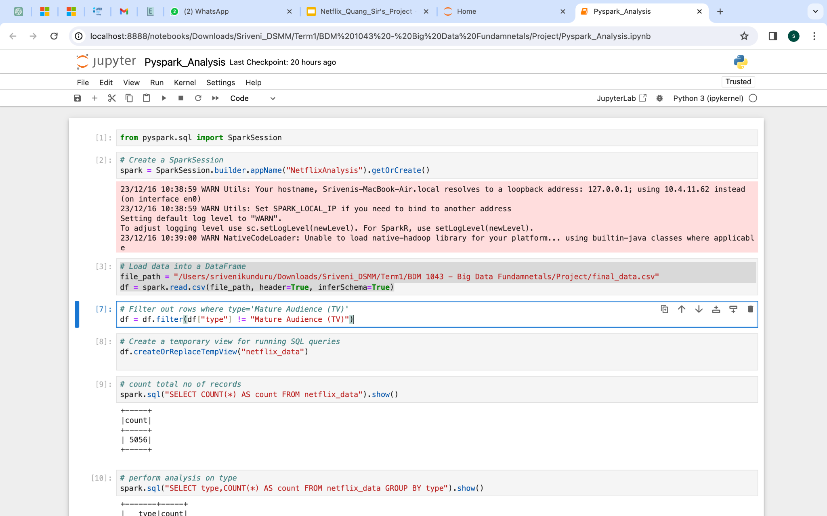
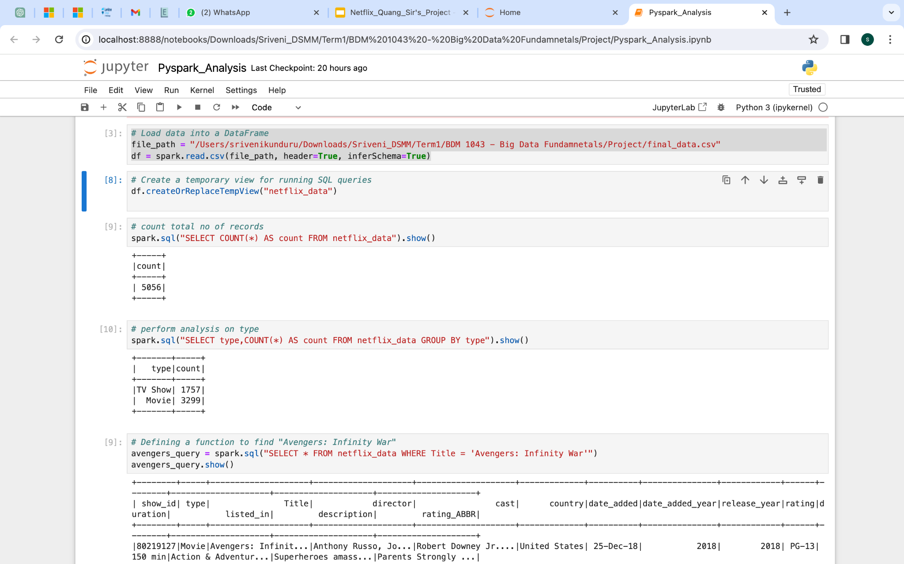
The initial step is to upload the final_data.csv(cleaned dataset with no outliers) into spark dataframe.
Further we have created a temporary view to perform some SQL queries using spark on the given dataset.
Data Analysis using Spark

Slide 27
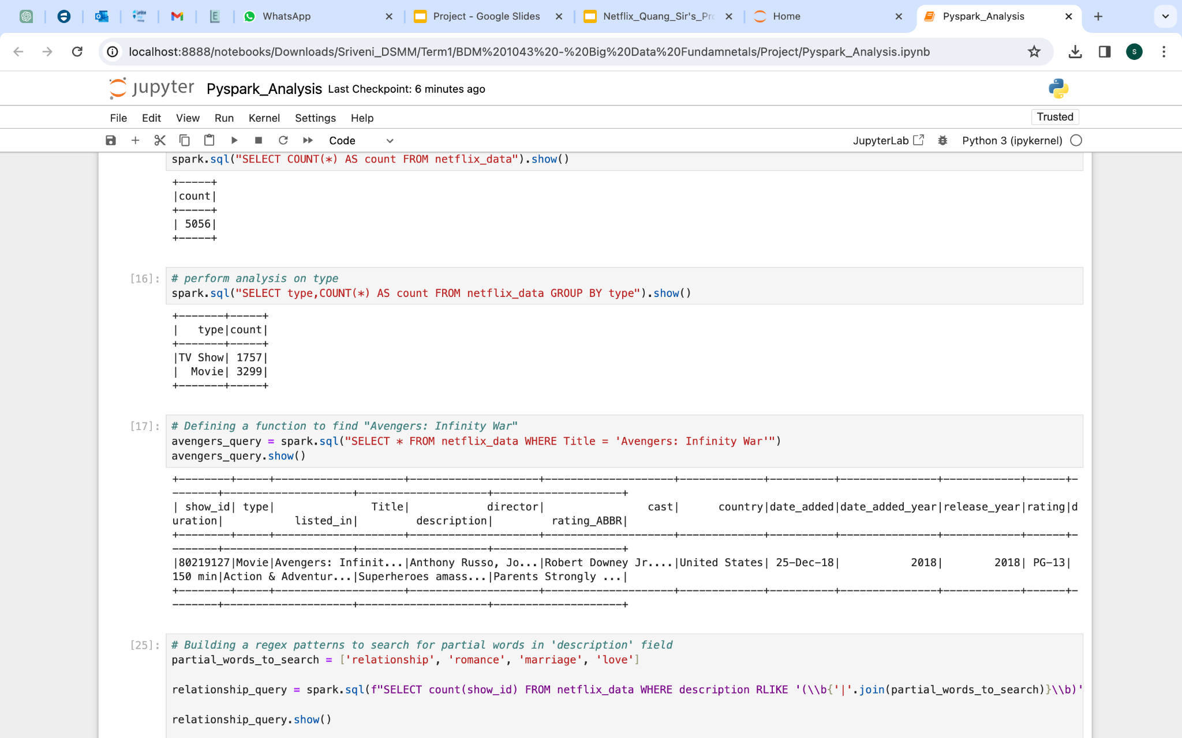
The first query here checks for the types of content available on Netflix.
Second query checks for particular title of a movie and its related information available in different attributes.

Slide 28
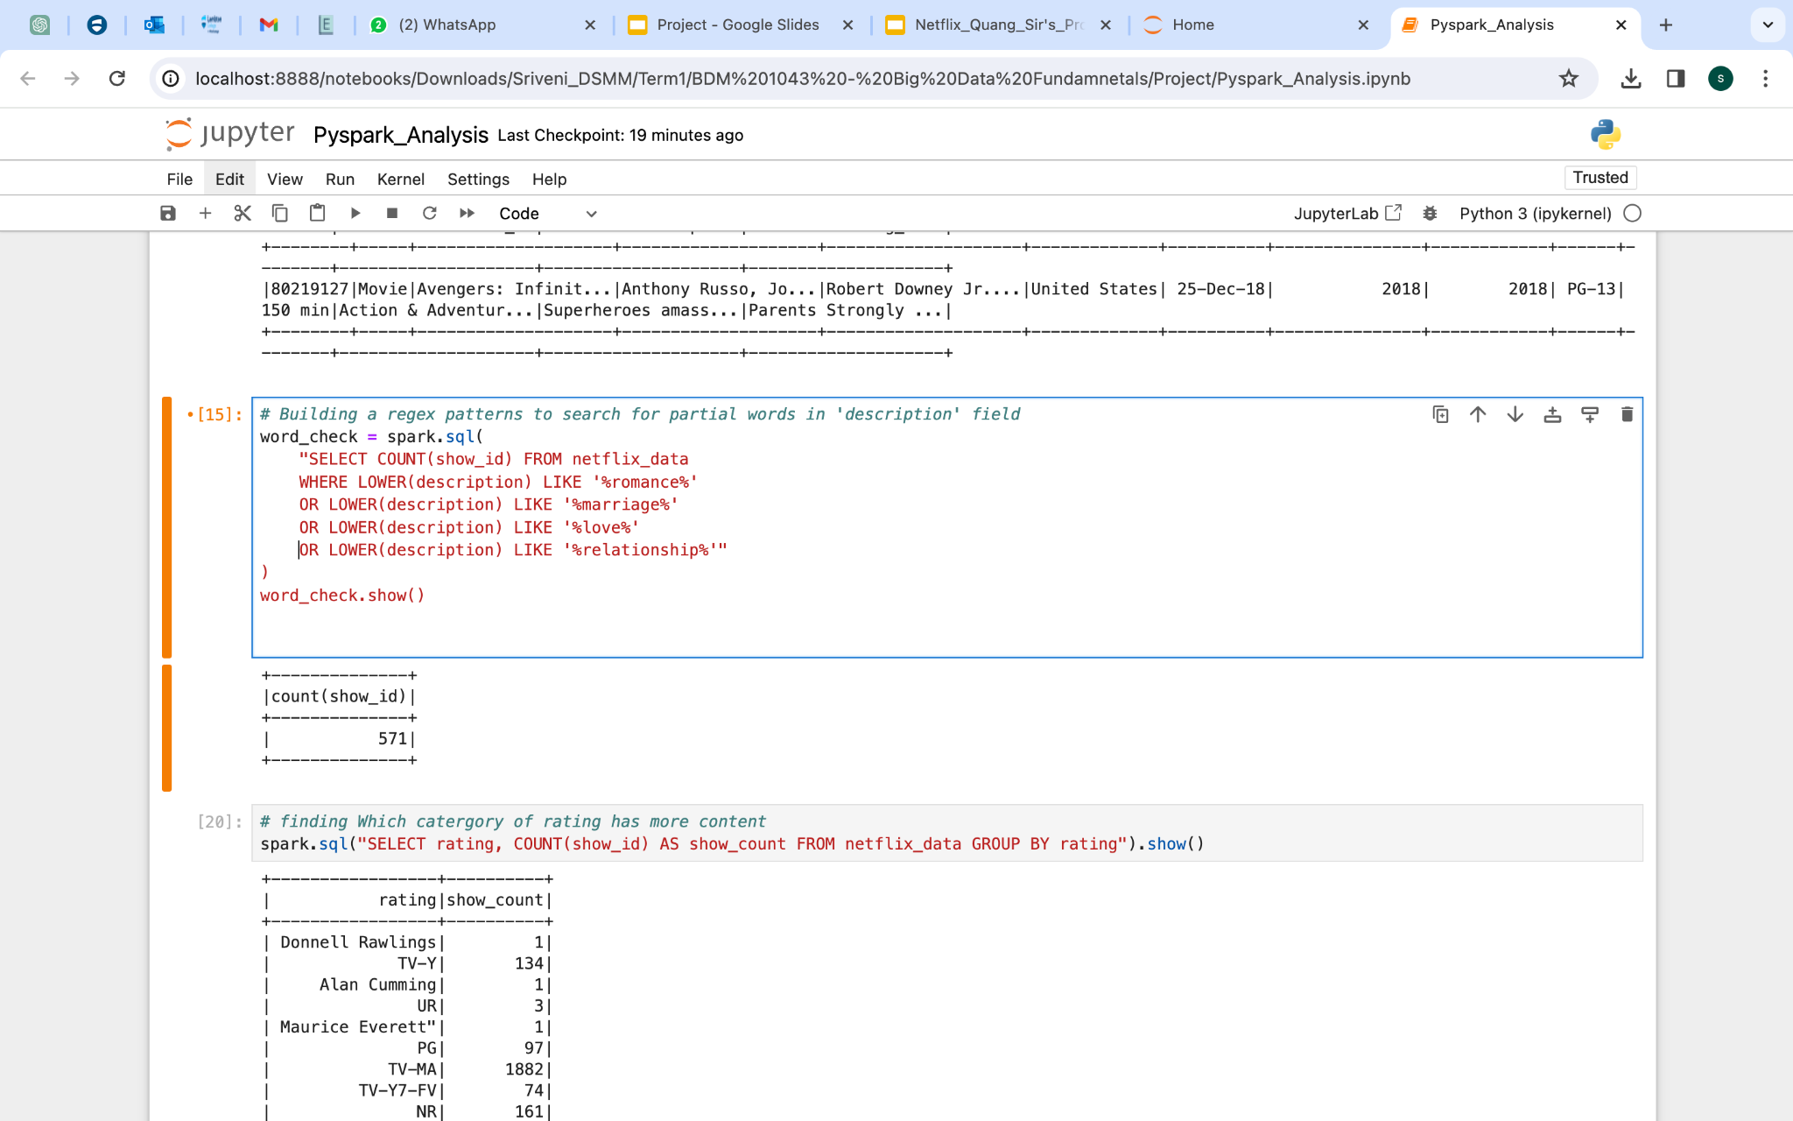
For instance, by using the LIKE and OR operators to search for a list of words, including “relationship”, “romance”, “marriage”, and “love” in the description column, we figured that there are 571 movies/TV shows involving these emotions.

Slide 29
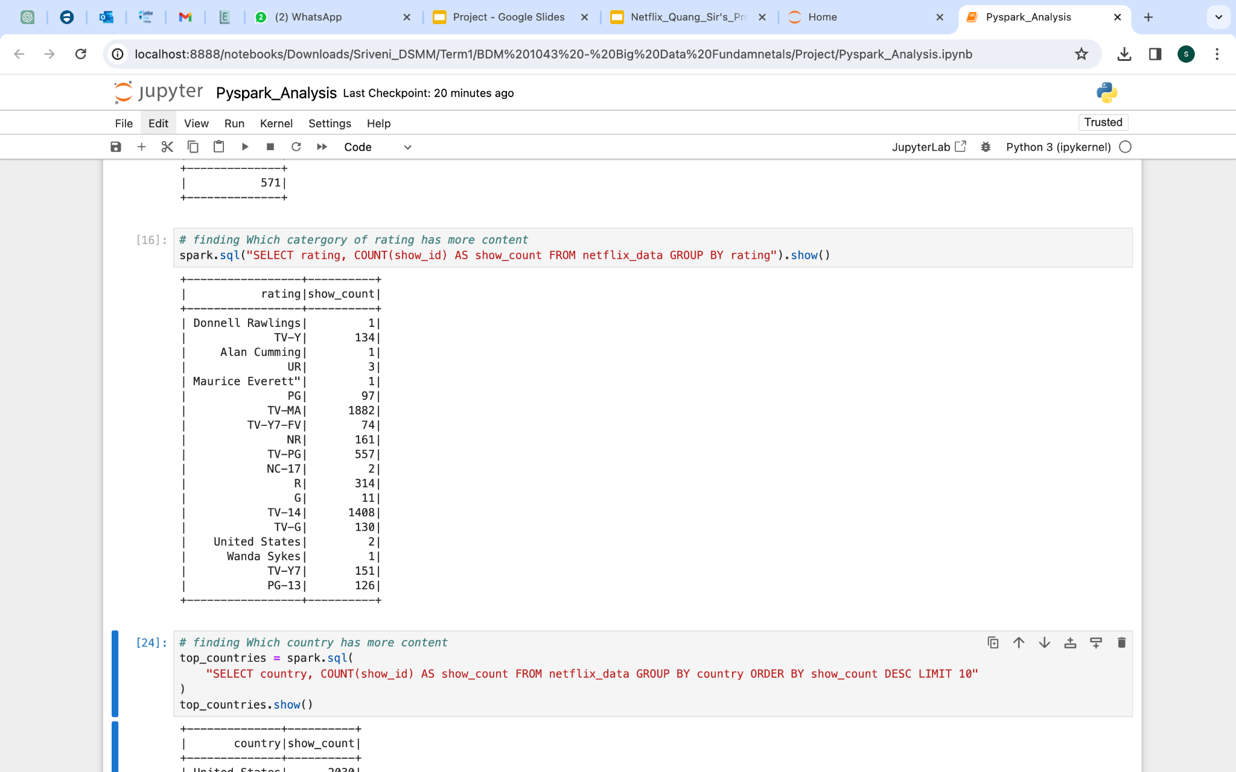
The following query retrieves the count of movies/TV shows for each rating from the dataset. Clearly, TV-MA and TV-14 were the most accessible content on Netflix!

Slide 30
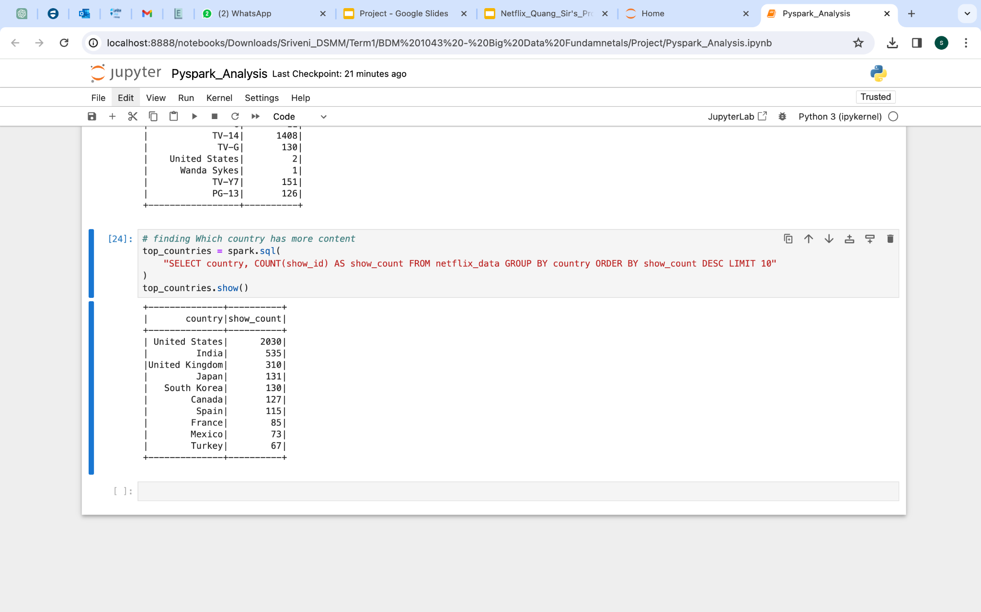
Here, we calculated the number of content generating countries, and discovered that US, India and UK produces the most content for the platform.

Slide 31
Data Visualization Using Tableau
Netflix contains a diverse collection of entertainment , we divided the data between TV shows and the movies to understand the audience’s primary interest. Our primary goal is to gain valuable insights into audience preferences. Understanding the distribution of content types allows us to discern whether viewers on the platform are more inclined towards TV shows, movies, or a balance mix of both. This knowledge is instrumental in shaping strategic decisions, enabling us to align content offerings with the evolving tastes and preferences of the audience. Ultimately, the aim is to enhance the overall viewer experience and ensure that the content library reflects the diverse interests of the users.

Slide 32
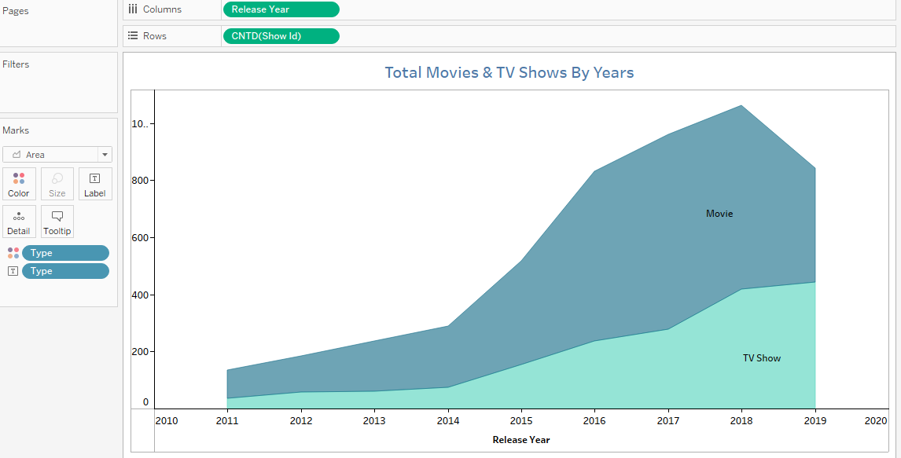
Total No. of Movies/Show Released Per Year
The area chart visually encapsulates the dynamic evolution of netflix content over the years. Each shaded area represents the cumulative total of both movies and TV shows released annually.
Insights:
1. Dominance of movies

Slide 33
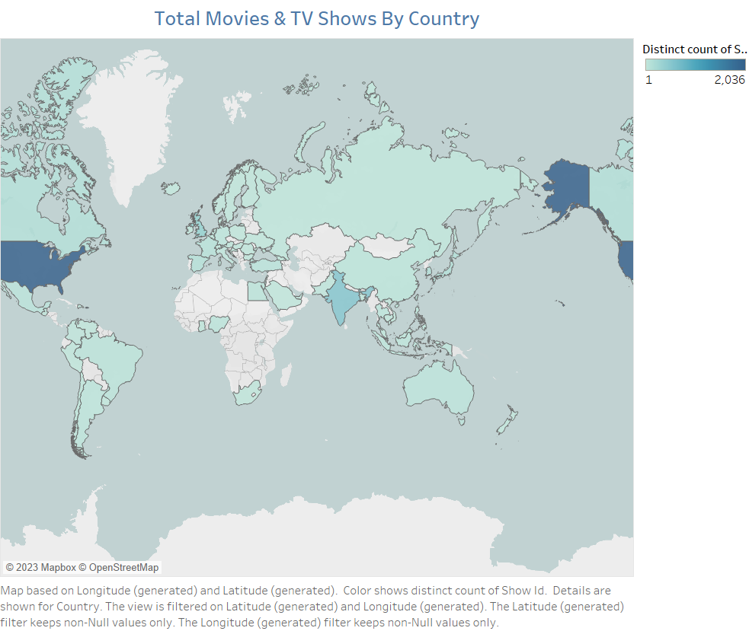
No. of Movies/Shows by Country
This vibrant map serves as a comprehensive visual representation of Netflix’s content distribution worldwide, highlighting the total number of TV shows and movies available in each country.
Insights:
1.Content localization.

Slide 34
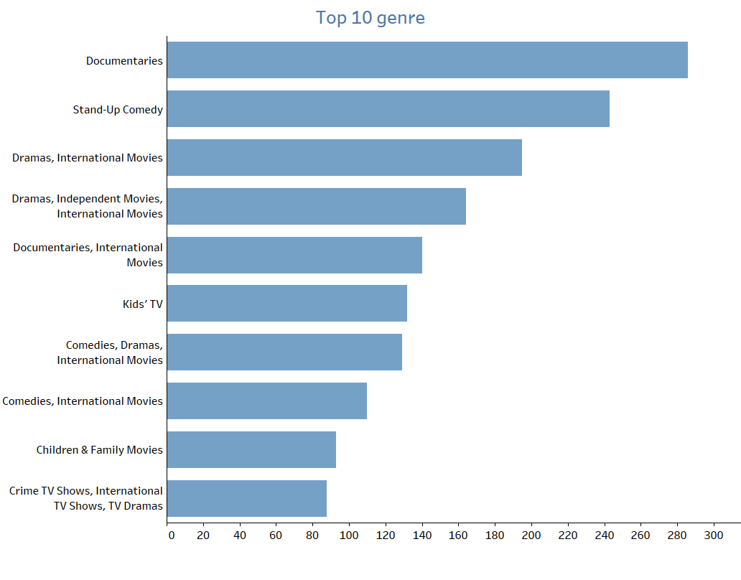
Top 10 Genres On Netflix
This horizontal bar graph offers a concise yet powerful snapshot of the most prevalent genres in Netflix’s content library. Each bar represents the popularity of a genre, with the length of the bar indicating its prevalence among the top 10 genres.
Insights:
1.Viewer preferences

Slide 35
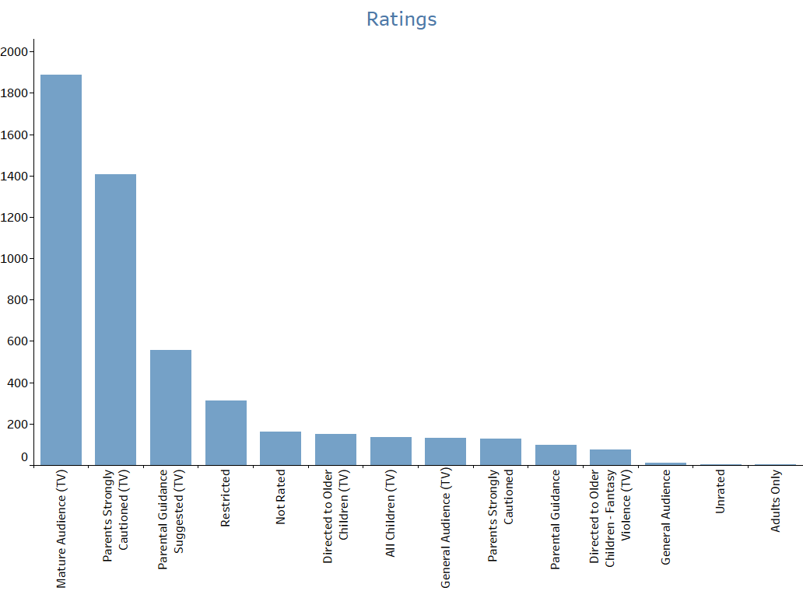
Top 10 Ratings On Netflix
This bar graph visually represents the ratings of Netflix TV shows and Movies categorised by different maturity levels.
Insights:
1.Targeted content.

Slide 36
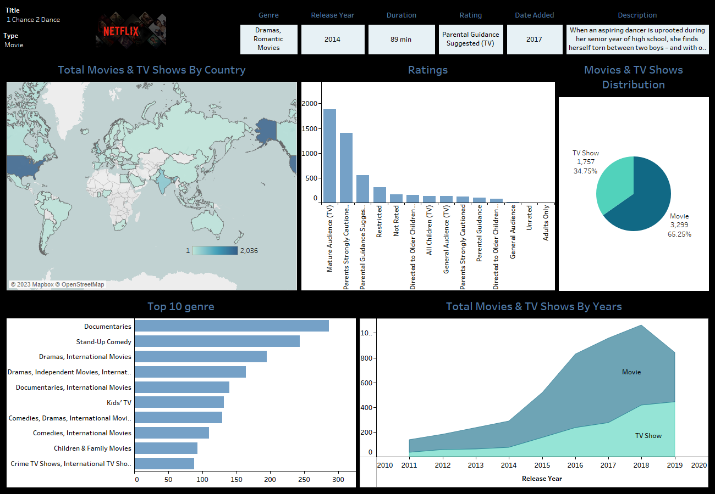
Netflix Dashboard
Bringing it all together, our interactive dashboard allows us to explore the data dynamically. Filter by genre , release year , or country to gain a personalised understanding of the content landscape.

Slide 37
Conclusion
After analyzing the data, we figured that more proportion of movies were released over the years as compared to the TV shows, whereas there was a significant increase in the number of TV shows released.
Secondly, majority of the Netflix content belongs to the Mature audience, which is mostly produced in the USA, India and UK.
Documentaries and Stand-Up Comedy are the most available genres on the platform!

Slide 38
Recommendation
Firstly, the increasing proportion of TV Shows indicates the possible market growth. Therefore, there’s a good scope of generating profit for the production houses currently investing in directing TV Shows.
Secondly, Netflix should bring more content available under all categories in order to increase its audience that is, its market size. It can also analyze the Movie/TV Show production data from countries, including USA, India and UK to understand the reasons behind their meritorious contributions to the platform. Eventually, the insights can be used for business expansion in other countries.
Finally, the reasons behind the large number of Documentaries and Stand-Up Comedies available on the platform can be the actual demand (more viewers data required to prove) or the flexibility that Netflix offers in generating and uploading self-produced content.

Slide 39
GitHub
GitHub is a platform revolutionizing collaboration in software development. It serves as a hub for version control, enabling multiple contributors to work on projects simultaneously. Through repositories, developers can store code, track changes, and merge alterations seamlessly. Its branching feature facilitates experimentation without disrupting the main codebase. GitHub fosters teamwork by allowing users to review, comment, and suggest modifications, streamlining the development process. Moreover, it provides a space for issue tracking, ensuring efficient bug fixes and enhancements. Ultimately, GitHub democratizes coding by offering a user-friendly interface, empowering developers worldwide to collaborate, innovate, and create impactful software solutions.

Slide 40
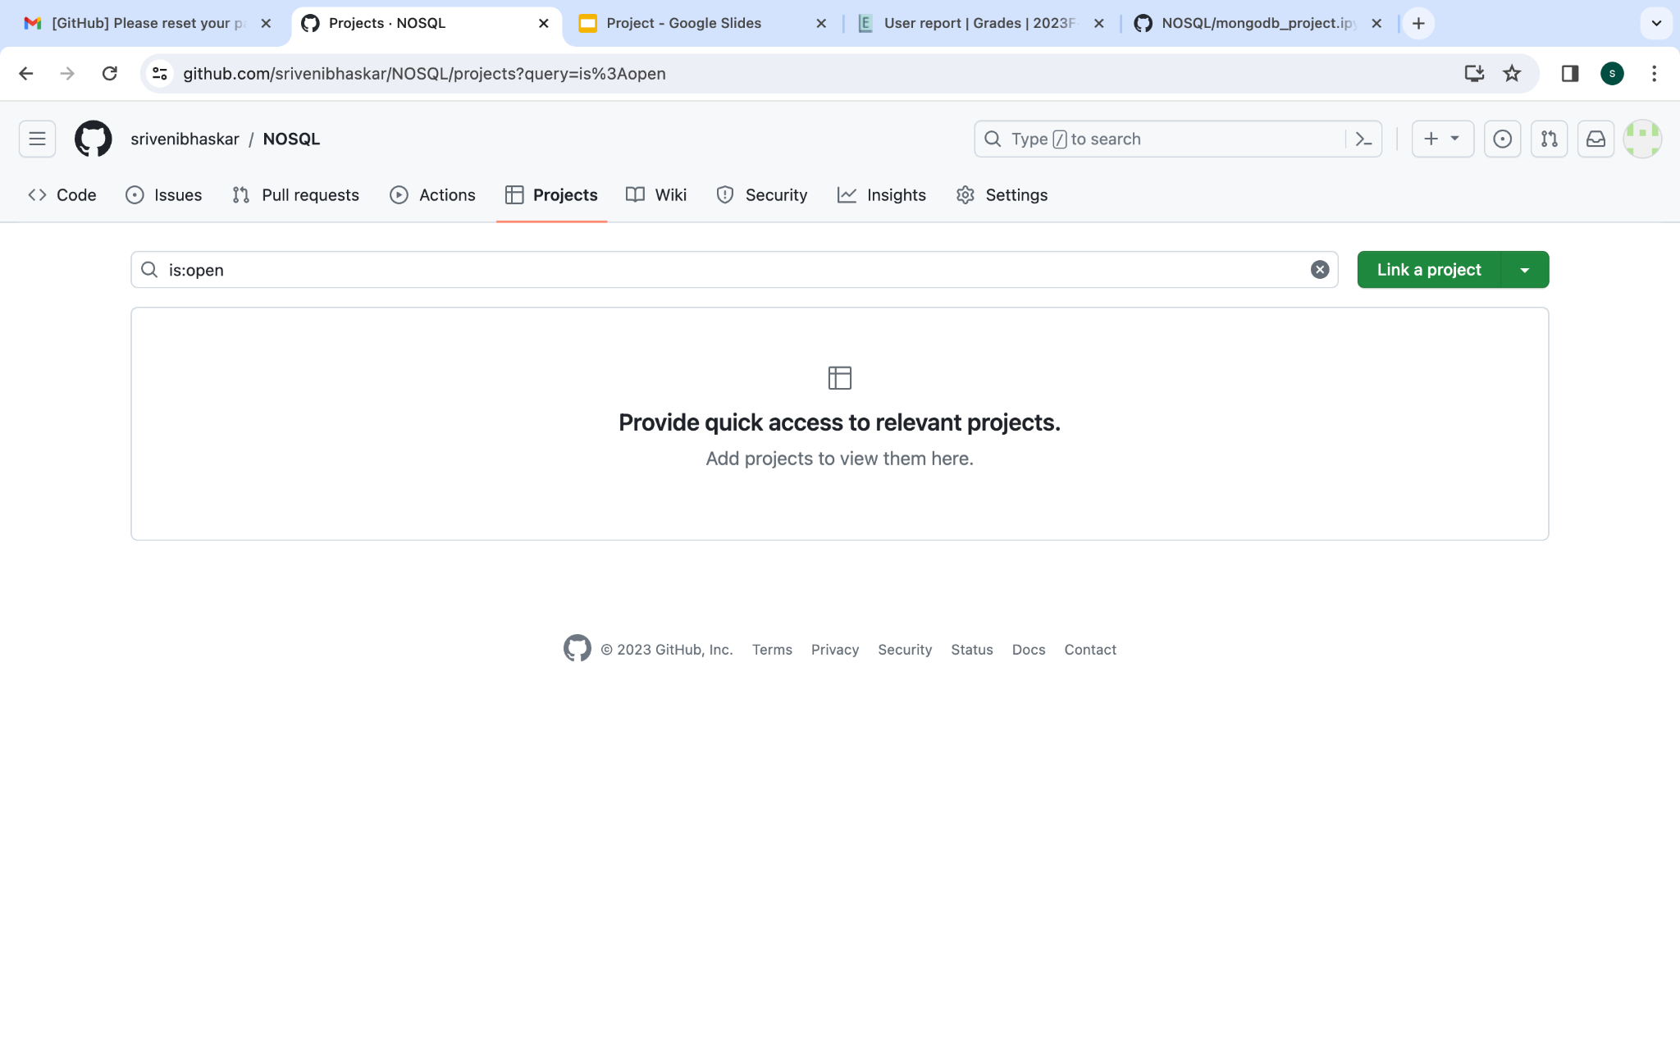
Usage of Git & GitHub
Firstly, we created a Github account and installed Git on our PC in order to upload and retrieve project updates from the remote repository.

Slide 41
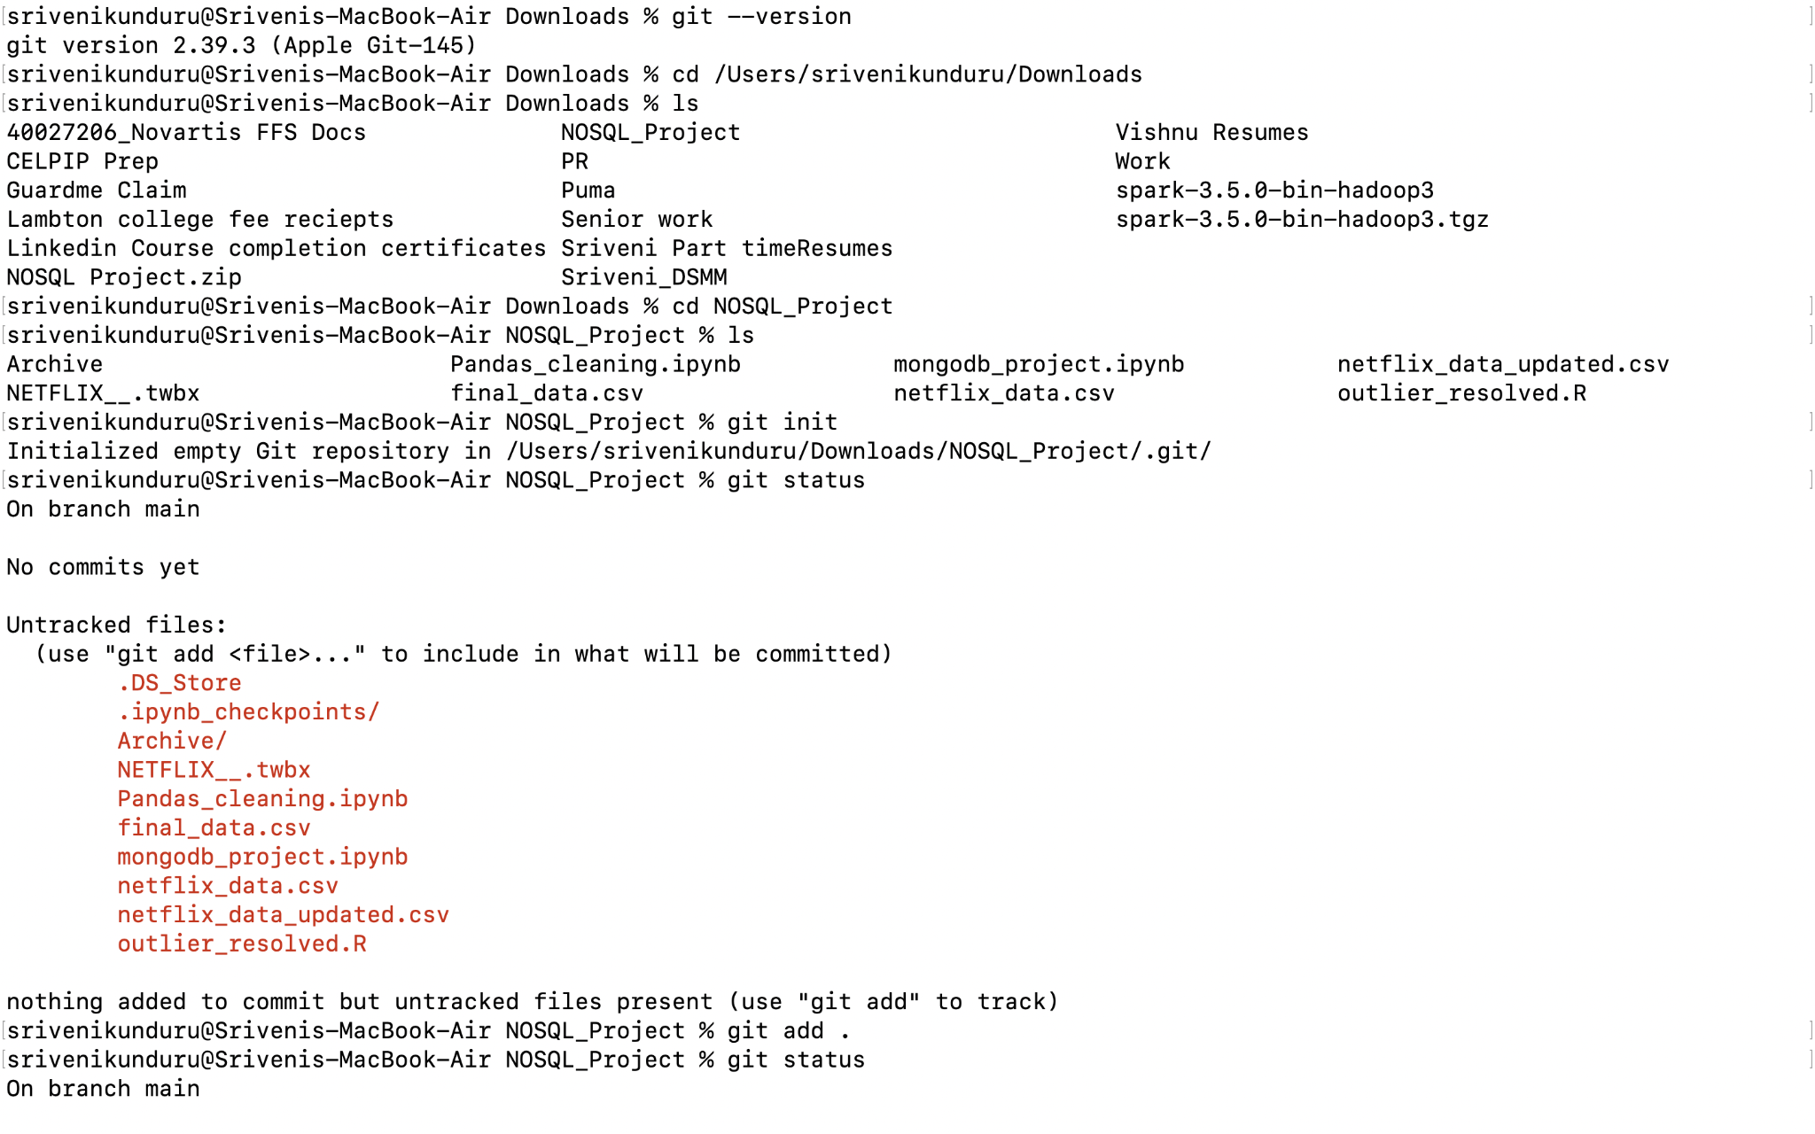
After that, we created a Project folder on our local machine, and used the “git init” command to turn it into a Git repository.
The “git status” command displays the state of the working directory. It lets you see which changes have been staged, which haven't, and which files aren't being tracked by Git.

Slide 42
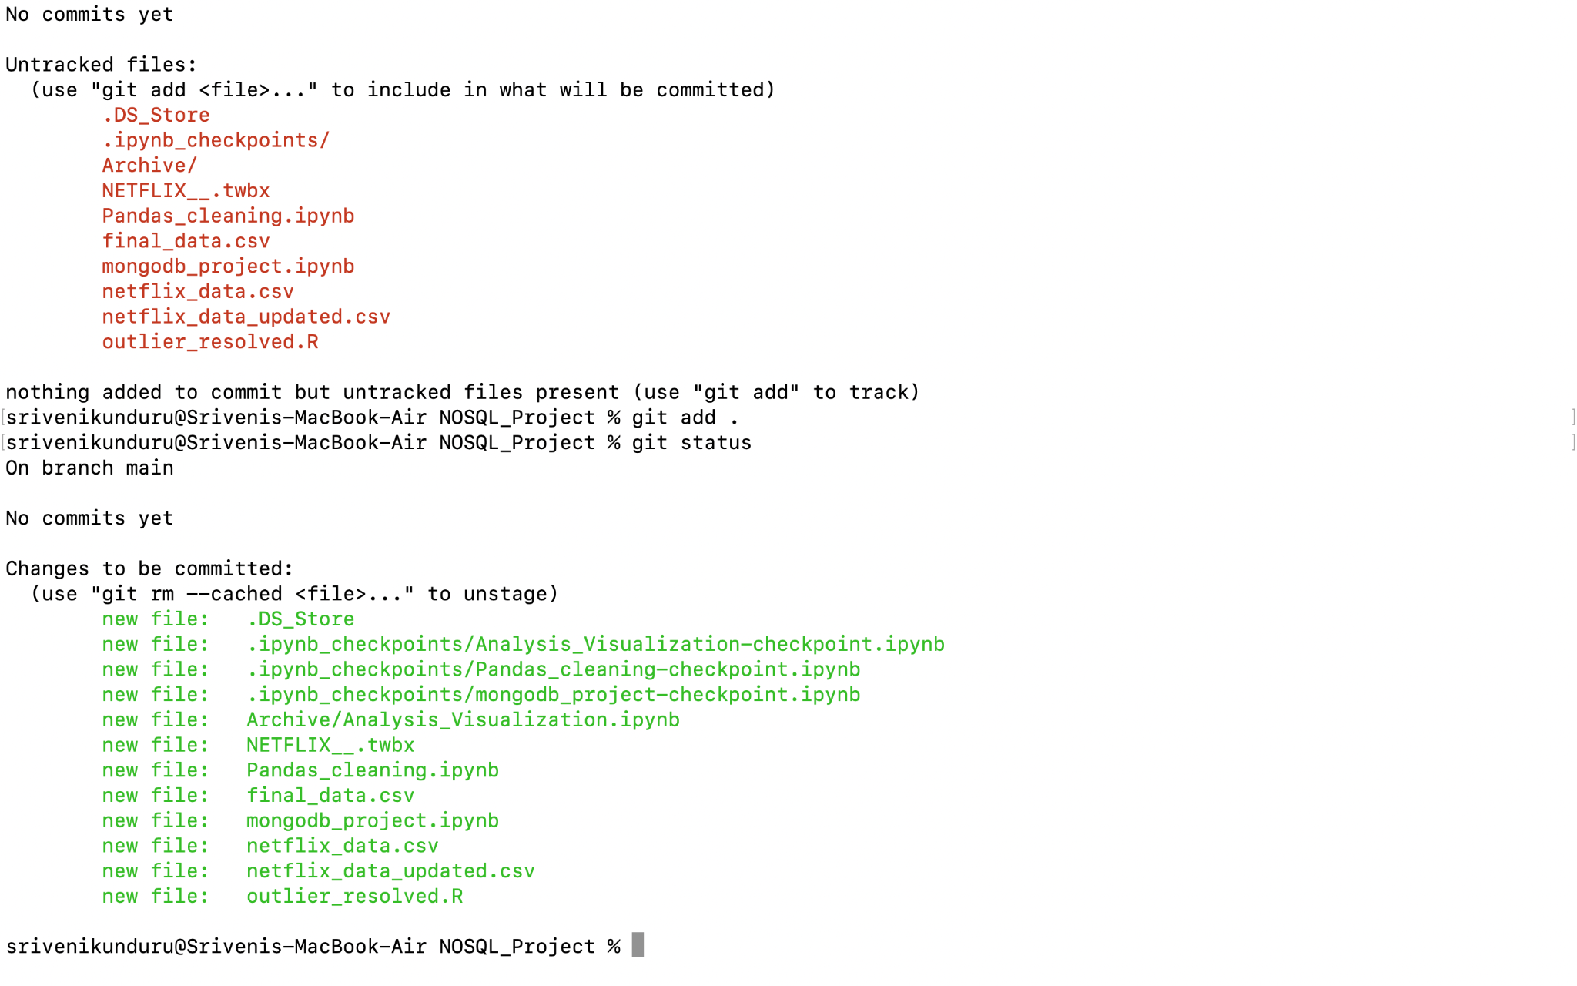
Now, we have our code files and data files along with some built in files in the repository.
We have uploaded all of it at a time using the “git add .” command where . represents that all files in that folder will be added to repository. We can also add specific files using git add <filename> command.

Slide 43
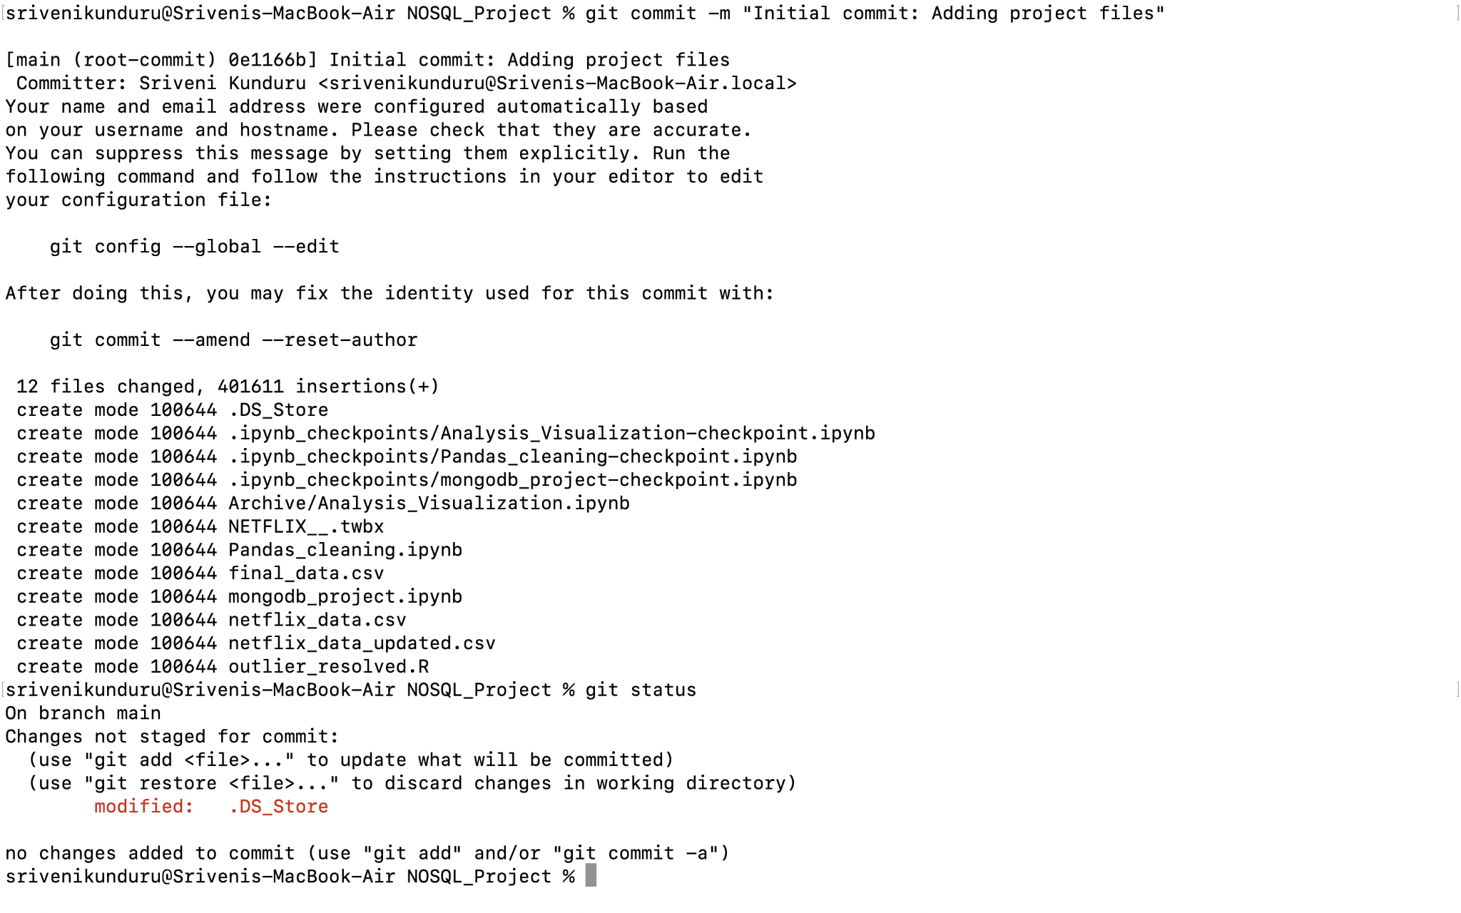
The “git commit” command to capture the state of a project at that point in time, and a 50 characters long message can also be attached, describing the changes we made to the project.
Syntax: git commit -m “message”

Slide 44
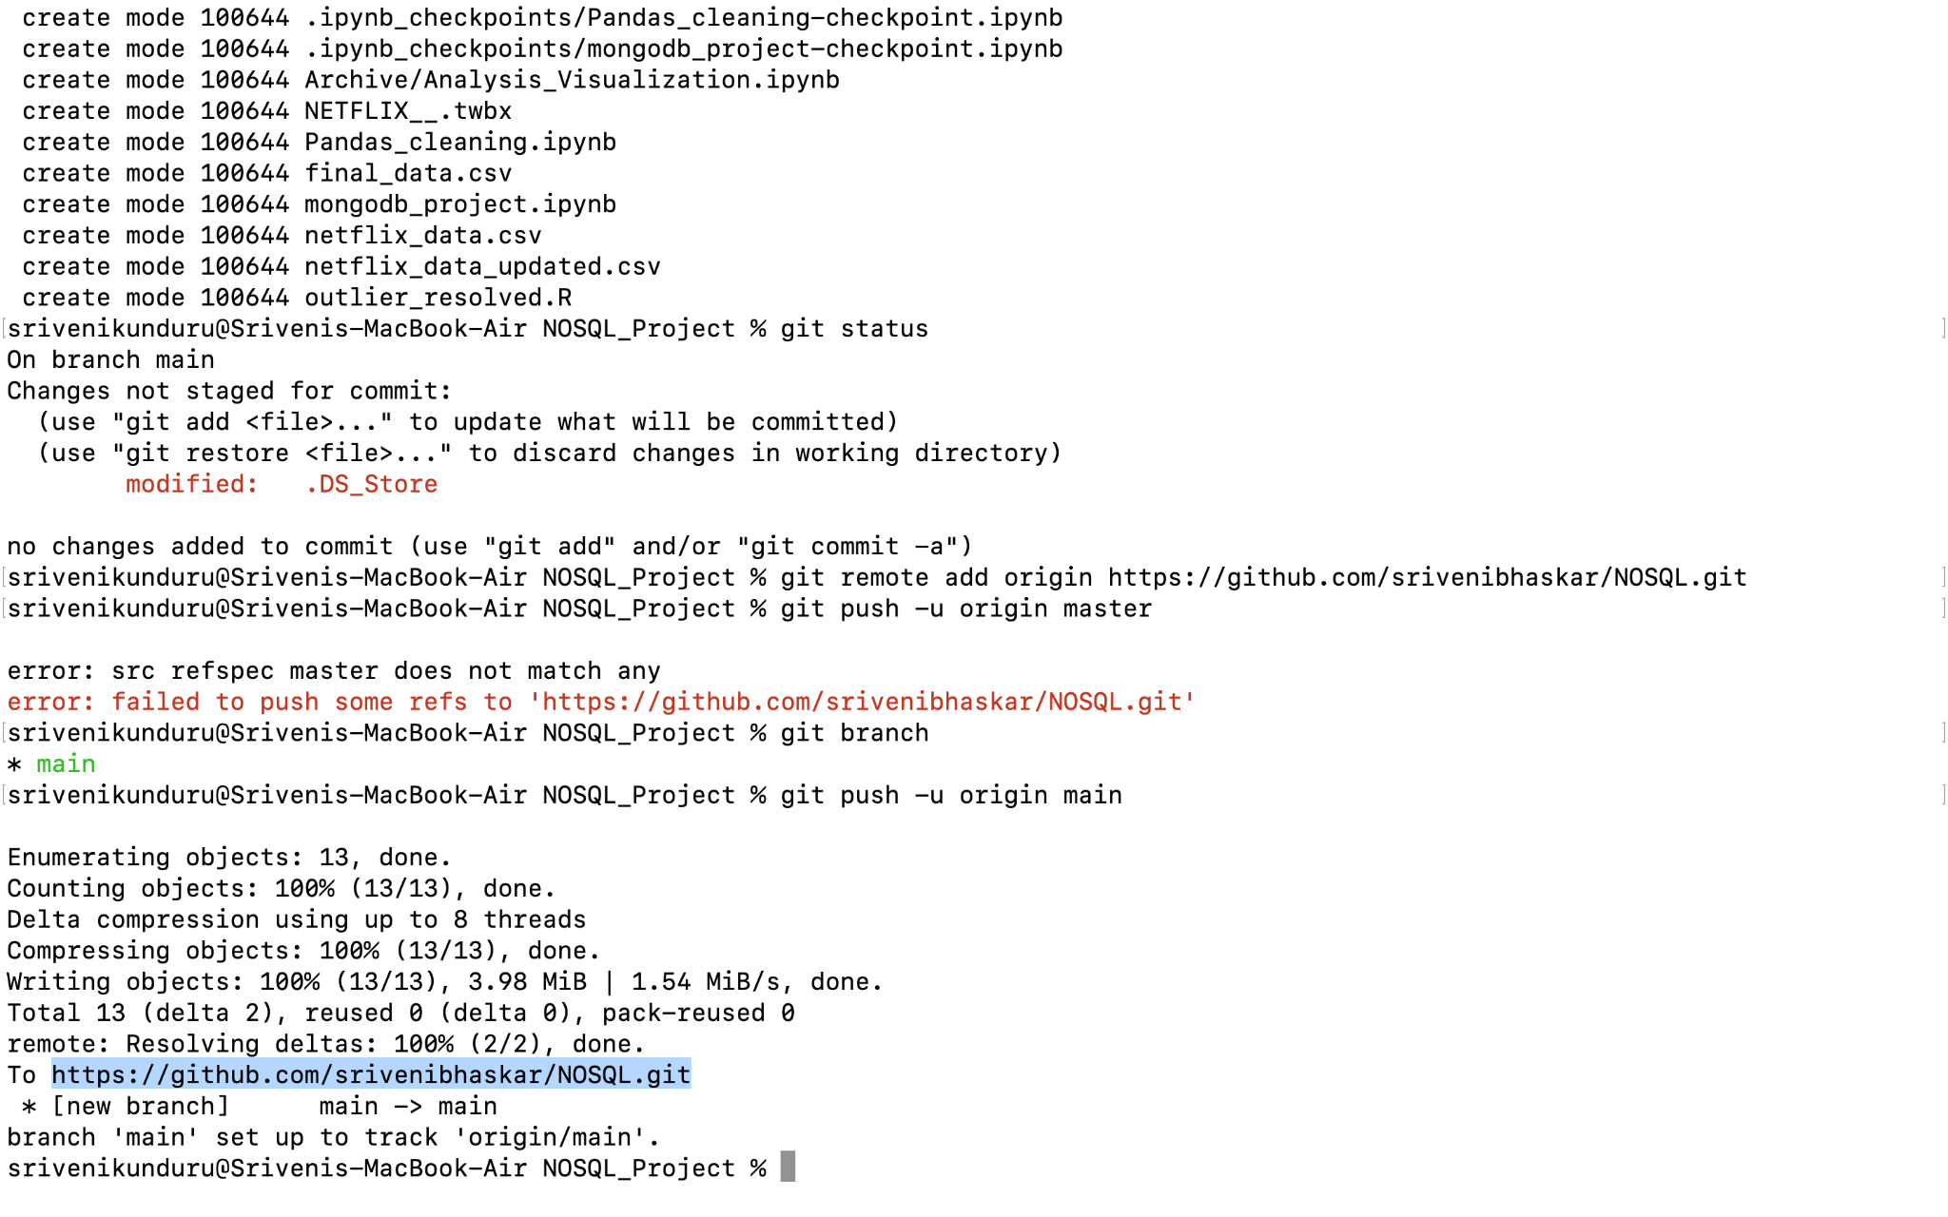
Then, we should add our remote repository using the url from git account and push the files to remote repository using git push command. In order to verify you are using the right branch, we run the git branch command and to move to a specific branch you can use git checkout <branch_name>.

Slide 45
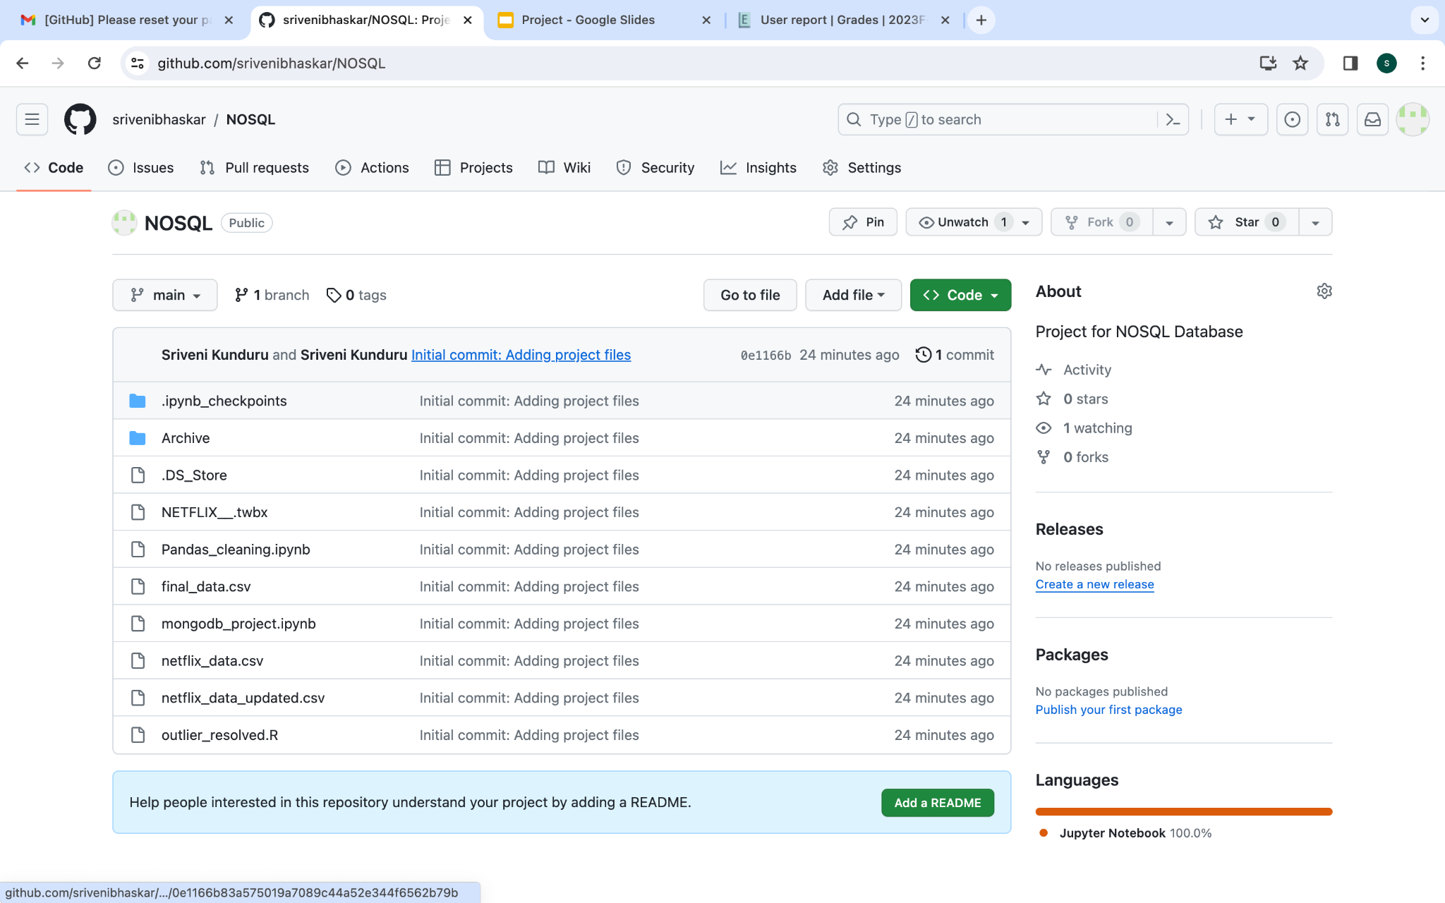
And this our final remote repository with the code files pushed into it.

Slide 46
Thank you!
(Merci)

